Slide 1
 |  | Predicted Class
 |  | Positive | Negative
Actual Class | Positive | True Positive (TP) | False Negative (FN)
 | Negative | False Negative (FN) | True Negative (TN)

Slide 2


User
5
4
High-order
Low-pass Filter
Ratings
Combine
Item
1
4
1
5
Filter
Combine
Good ratings
1
3
Cluster
5
High-order
Low-pass Filter
Bad ratings
2
3
3
4
Filter
Ideal Low-pass Filter
$$F_{I}=D_{I}^{−\frac{1}{2}}\overline{U}{\overline{U}}^{T}D_{I}^{\frac{1}{2}}$$
 | 1 | 2 | 3 | 4 | 5
1 | 1 | 0 | 0 | 1 | 0
2 | 1 | 0 | 0 | 0 | 0
3 | 0 | 0 | 0 | 1 | 0
4 | 0 | 0 | 1 | 0 | 0
5 | 0 | 0 | 1 | 0 | 1
Ideal Low-pass Filter
Ratings
Filter
Combine
High-order Low-pass Filter
$$F_{H}=I −{(I−{\tilde{R}}^{T}R\text{)}}^{k_{2}}$$
High-order
Low-pass Filter
Filter
2
High-order
Low-pass Filter
Ratings
4
5
1
4
1
5
Filter
Combine
1
3
Cluster
High-order
Low-pass Filter
3
5
2
2
4
3
Filter
 | 1 | 2 | 3 | 4 | 5
1 | 1 | 0 | 0 | 1 | 0
2 | 1 | 1 | 0 | 0 | 0
3 | 1 | 0 | 1 | 1 | 1
4 | 0 | 0 | 1 | 0 | 0
5 | 0 | 0 | 1 | 0 | 1
Ideal Low-pass Filter
Ratings
Filter
Combine
High-order
Low-pass Filter
Filter
Final Ratings

Slide 3
User
Item
3
High-order
Low-pass Filter
Prediction
1
4
3
2
2
Filter
1
4
3
Cluster
3
4
2
High-order
Low-pass Filter
2
1
3
Filter
1
4
Combine
 | 1 | 2 | 3 | 4
1 | 0 | 0 | 1 | 1
2 | 0 | 0 | 0 | 1
3 | 1 | 1 | 1 | 0
4 | 1 | 1 | 0 | 0
Ideal Low-pass Filter
Filter
High-order
Low-pass Filter
Filter

Slide 4






사용자 1
유사
유사
추천
추천
사용자 2
사용자 기반 협업 필터링
아이템 기반 협업 필터링

Slide 5

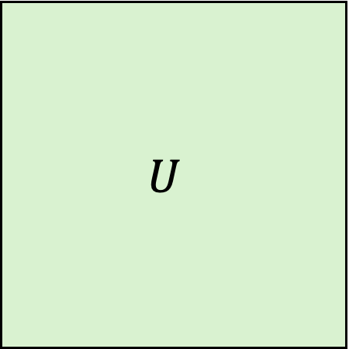

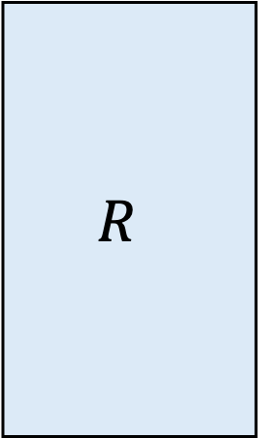


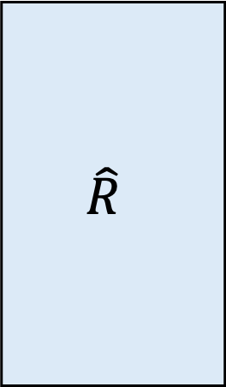

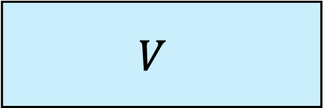

$$R$$
$$U$$
$$V$$
$$\hat{R}$$
$$k × m$$
$$=$$
$$∙$$
$$=$$
$$m × n$$
$$m × k$$
$$m × n$$

Slide 6

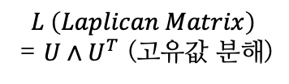








1
$$L \left(Laplican Matrix\right)$$
= $U∧U^{T}$ (고유값 분해)
4
$$Uh(∧)U^{T}X$$
Fourier Transform
Inverse FT
2
Frequency Domain
3
Frequency Domain
$$U^{T}X$$
$$h(∧)U^{T}X$$
Filtering
Filter out
$$λ_{1}$$
$$λ_{2}$$
$$λ_{3}$$
$$λ_{1}$$
$$λ_{2}$$
$$λ_{3}$$

Slide 7
Ranking
Output
Recommendations
Recommendations
Recommendations
Friendship
finder
Items
Database
Matchmaker
User profile
User
Request
Grouping users
Query
Transformer
Collaborative
Recommender
Content based
Recommender

Slide 8





















$$i_{1}$$
$$u_{1}$$
$$u_{1}$$
$$i_{2}$$
$$i_{3}$$
$$u_{2}$$
$$i_{2}$$
$$i_{1}$$
$$u_{2}$$
$$i_{3}$$
$$l=1$$
$$i_{4}$$
$$u_{3}$$
$$u_{3}$$
$$l=2$$
$$i_{5}$$
$$i_{4}$$
$$i_{4}$$
$$i_{5}$$
$$l=3$$
User-Item Interaction Graph
High-order Connectivity for $u_{1}$

Slide 9



































$${\tilde{y}}_{NGCF}(u_{1},i_{4})$$
Prediction Layer
$$e_{u_{1}}^{∗}$$
$$e_{i_{4}}^{∗}$$
Concatenate
Concatenate
$$e_{u_{1}}^{(3)}$$
$$e_{i_{4}}^{(3)}$$
$$e_{u_{1}}^{(2)}$$
$$e_{i_{4}}^{(2)}$$
$$e_{u_{1}}^{(1)}$$
$$e_{i_{4}}^{(1)}$$
$$l=3$$
$$l=3$$
$$l=2$$
$$l=2$$
$$l=1$$
$$l=1$$
Embedding Propagation Layers
$$W_{1}^{(l)}$$
$$W_{2}^{(l)}$$
$$W_{1}^{(l)}$$
$$W_{2}^{(l)}$$
$$u_{1}$$
$$i_{1}$$
$$⋯$$
$$i_{2}$$
$$i_{4}$$
$$u_{2}$$
$$⋯$$
$$u_{3}$$
$$e_{u_{1}}^{(l−1)}$$
$$e_{i_{1}}^{(l−1)}$$
$$e_{i_{2}}^{(l−1)}$$
$$e_{i_{4}}^{(l−1)}$$
$$e_{u_{2}}^{(l−1)}$$
$$e_{u_{3}}^{(l−1)}$$
$$e_{u_{1}}^{(0)}$$
$$e_{i_{4}}^{(0)}$$
Embeddings

Slide 10




















Prediction
Layer Combination (weighted sum)
$$e_{u_{1}}^{(3)}$$
$$e_{i_{4}}^{(3)}$$
$$e_{u_{1}}^{(2)}$$
$$e_{i_{4}}^{(2)}$$
$$e_{u_{1}}^{(0)}$$
$$e_{i_{4}}^{(0)}$$
$$e_{u_{1}}^{(1)}$$
$$e_{i_{4}}^{(1)}$$
$$l=3$$
$$l=3$$
$$l=2$$
$$l=2$$
$$l=1$$
$$l=1$$
Normalized Sum
Normalized Sum
$$i_{1}$$
$$i_{2}$$
$$i_{3}$$
$$u_{2}$$
$$u_{3}$$
$$e_{i_{1}}^{(l−1)}$$
$$e_{i_{2}}^{(l−1)}$$
$$e_{i_{3}}^{(l−1)}$$
$$e_{u_{2}}^{(l−1)}$$
$$e_{u_{3}}^{(l−1)}$$
Neighbors of $u_{1}$
Neighbors of $i_{4}$

